Slide 1
Counting
CSI 219 – Discrete Mathematics
Course teacher: Minhajul Bashir

Slide 2
Permutation and Combination
Permutation: How do we choose 5 students out of 10 and arrange them in one line?
Combination: How do we choose 5 students out of 10 and form a committee?

Slide 3
Permutation
Ordered arrangement of distinct objects
Two permutations of five different colored balls

Slide 4

Permutation
Ordered arrangement of distinct objects
$r$-permutation: ordered arrangement of $r$ objects from a set
Number of $r$-permutations of a set with $n$ elements $=P(n,r)$
How to count $P(n,r)$?

Slide 5
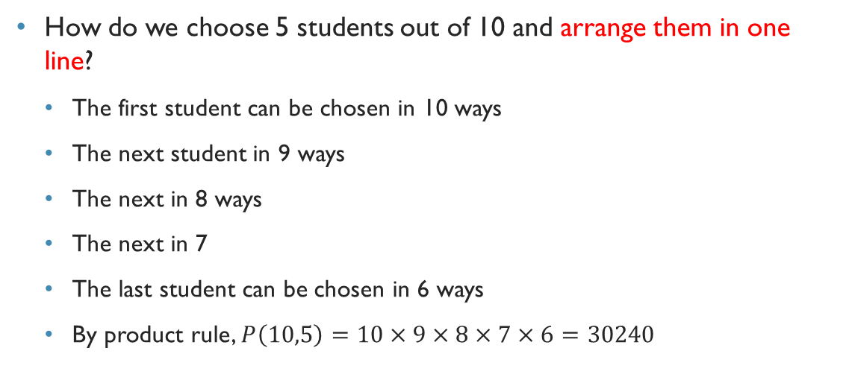
Permutation
How do we choose 5 students out of 10 and arrange them in one line?
The first student can be chosen in 10 ways
The next student in 9 ways
The next in 8 ways
The next in 7
The last student can be chosen in 6 ways
By product rule, $P\left(10,5\right)=10×9×8×7×6=30240$

Slide 6
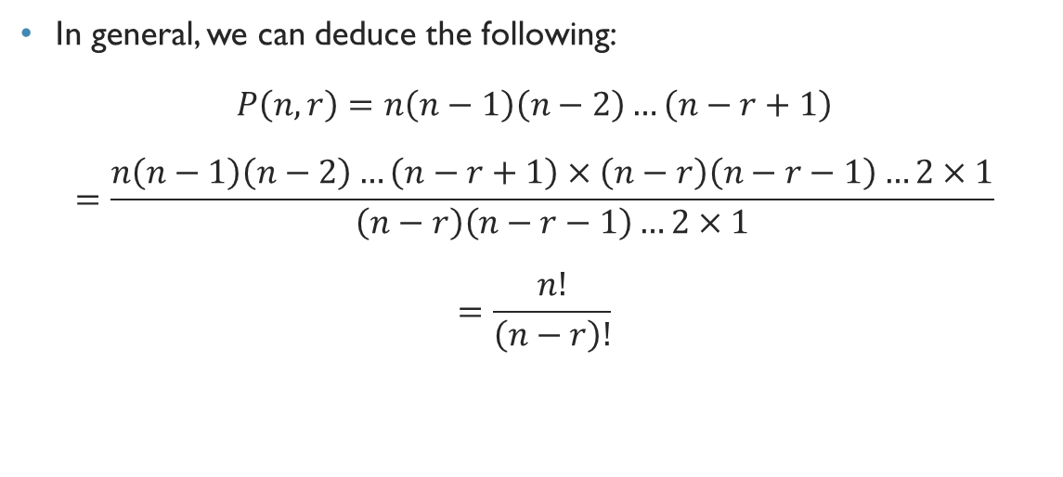
Permutation
In general, we can deduce the following:
$$P\left(n,r\right)=n\left(n−1\right)\left(n−2\right)…\left(n−r+1\right)$$
$$=\frac{n\left(n−1\right)\left(n−2\right)…\left(n−r+1\right)×\left(n−r\right)\left(n−r−1\right)…2×1}{\left(n−r\right)\left(n−r−1\right)…2×1}$$
$$=\frac{n!}{\left(n−r\right)!}$$

Slide 7
Combination
Unordered selection of distinct objects
We are only choosing the balls, not worrying about the order

Slide 8
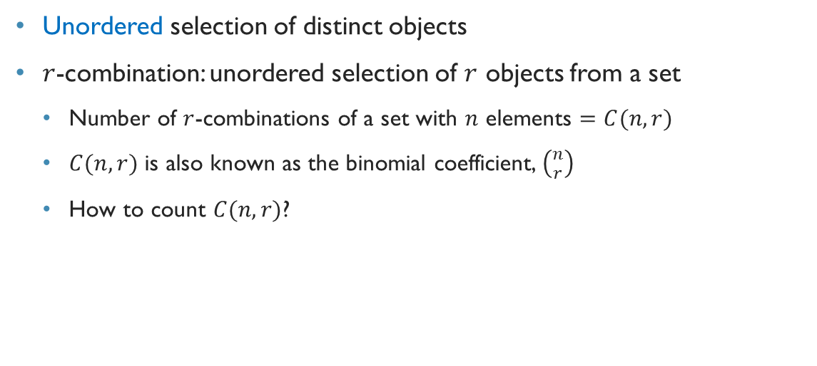
combination
Unordered selection of distinct objects
$r$-combination: unordered selection of $r$ objects from a set
Number of $r$-combinations of a set with $n$ elements $=C(n,r)$
$C(n,r)$ is also known as the binomial coefficient, $\left({n \atop r}\right)$
How to count $C(n,r)$?

Slide 9
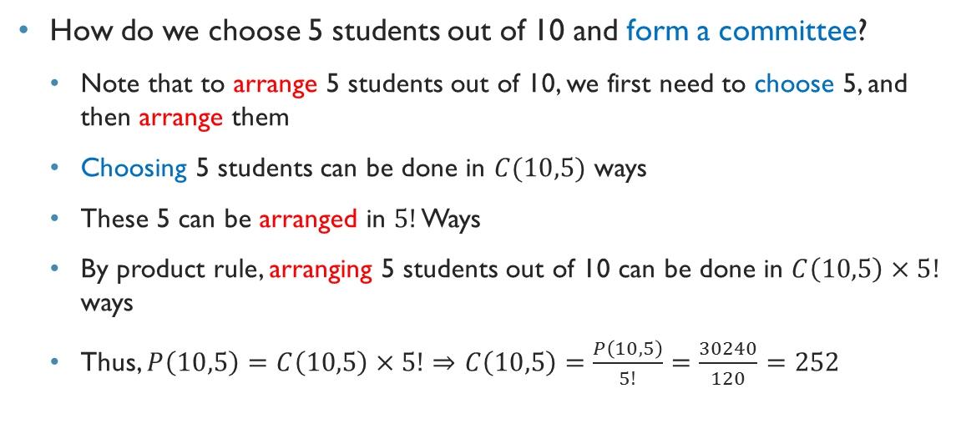
Calculate combination from permutation
How do we choose 5 students out of 10 and form a committee?
Note that to arrange 5 students out of 10, we first need to choose 5, and then arrange them
Choosing 5 students can be done in $C(10,5)$ ways
These 5 can be arranged in $5!$ Ways
By product rule, arranging 5 students out of 10 can be done in $C\left(10,5\right)×5!$ ways
Thus, $P\left(10,5\right)=C\left(10,5\right)×5!⇒C\left(10,5\right)=\frac{P\left(10,5\right)}{5!}=\frac{30240}{120}=252$

Slide 10
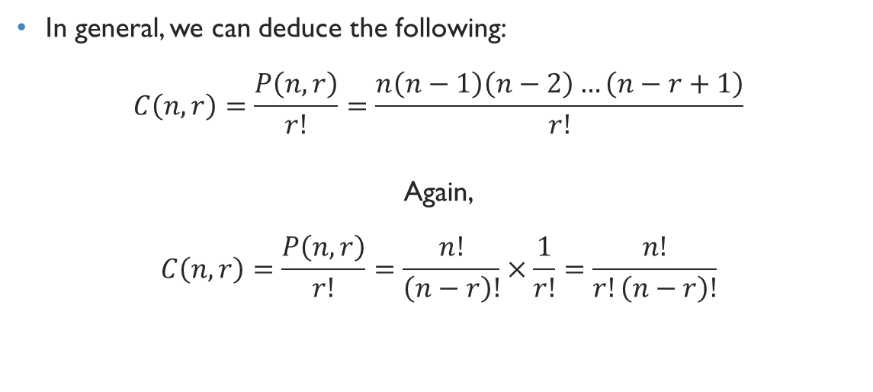
Combination
In general, we can deduce the following:
$$C\left(n,r\right)=\frac{P\left(n,r\right)}{r!}=\frac{n\left(n−1\right)\left(n−2\right)…\left(n−r+1\right)}{r!}$$
Again,
$$C\left(n,r\right)=\frac{P\left(n,r\right)}{r!}=\frac{n!}{\left(n−r\right)!}×\frac{1}{r!}=\frac{n!}{r!\left(n−r\right)!}$$

Slide 11

Exercise
Prove that $C\left(n,r\right)=C(n,n−r)$
Symmetry of binomial coefficient
Prove that $C\left(n,r\right)=C\left(n−1,r\right)+C(n−1,r−1)$
Recurrence of binomial coefficient

Slide 12
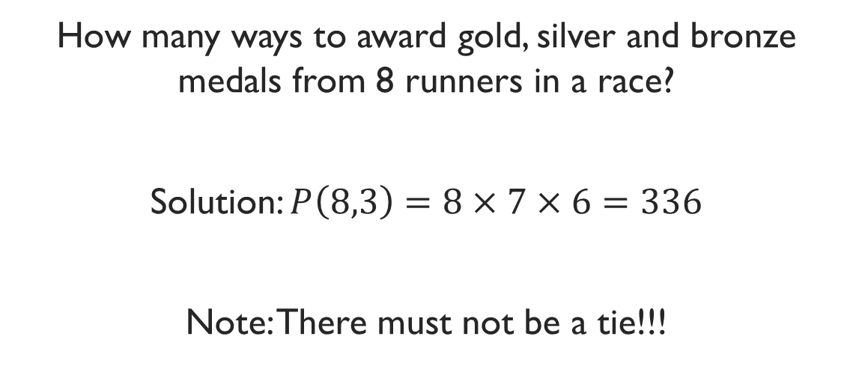
Example
How many ways to award gold, silver and bronze medals from 8 runners in a race?
Solution: $P\left(8,3\right)=8×7×6=336$
Note: There must not be a tie!!!

Slide 13
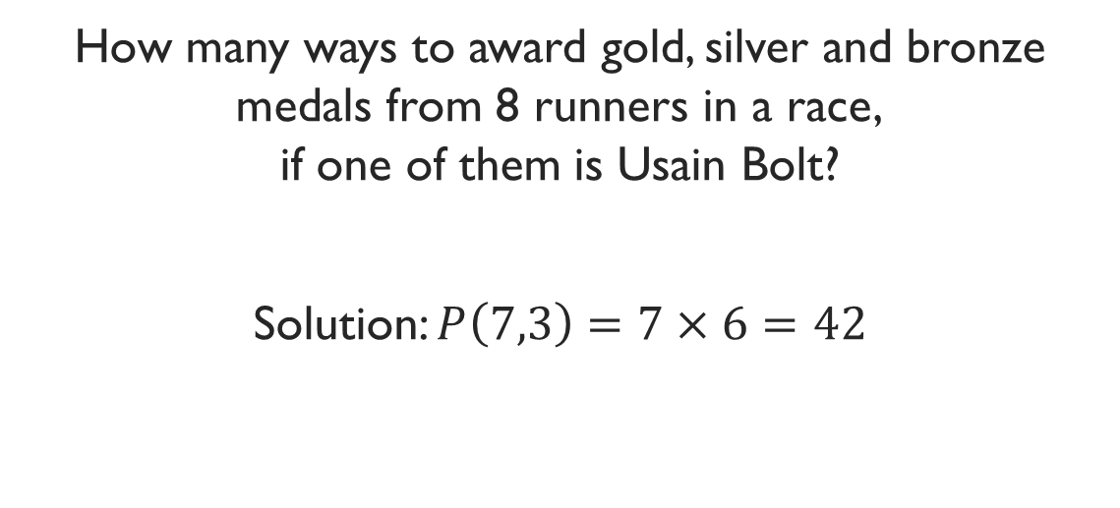
Example
How many ways to award gold, silver and bronze medals from 8 runners in a race, if one of them is Usain Bolt?
Solution: $P\left(7,3\right)=7×6=42$

Slide 14
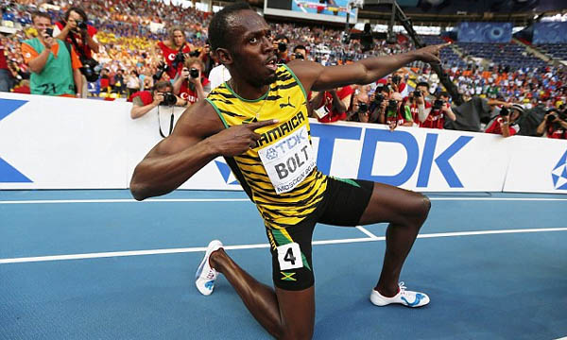
LIKE A BOSS

Slide 15
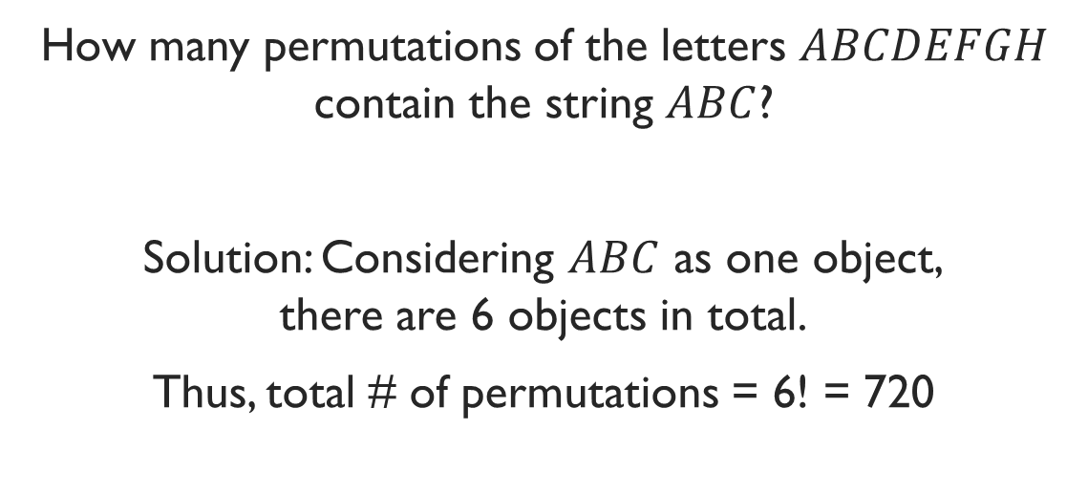
Example
How many permutations of the letters $ABCDEFGH$ contain the string $ABC$?
Solution: Considering $ABC$ as one object, there are 6 objects in total.
Thus, total # of permutations = 6! = 720

Slide 16
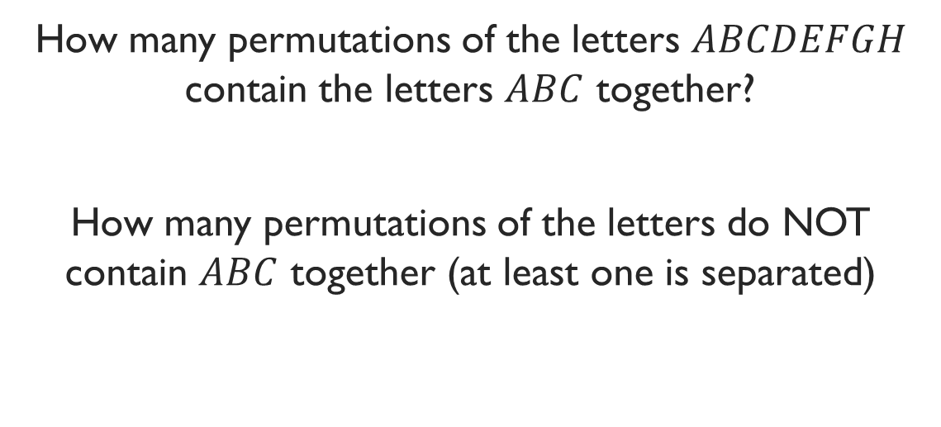
Exercise
How many permutations of the letters $ABCDEFGH$ contain the letters $ABC$ together?
How many permutations of the letters do NOT contain $ABC$ together (at least one is separated)

Slide 17
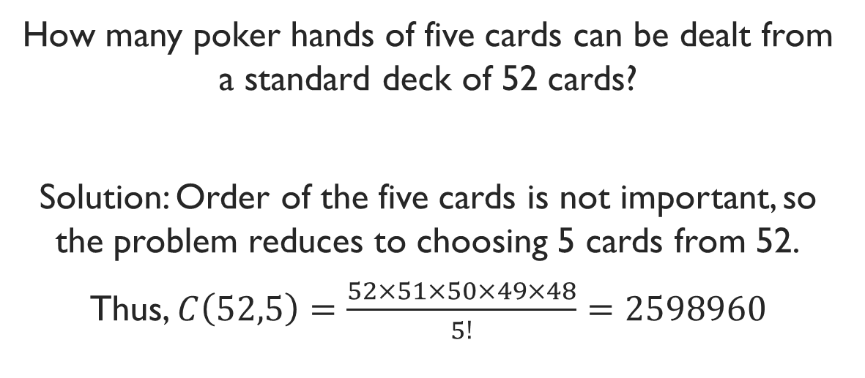
Example
How many poker hands of five cards can be dealt from a standard deck of 52 cards?
Solution: Order of the five cards is not important, so the problem reduces to choosing 5 cards from 52.
Thus, $C\left(52,5\right)=\frac{52×51×50×49×48}{5!}=2598960$

Slide 18
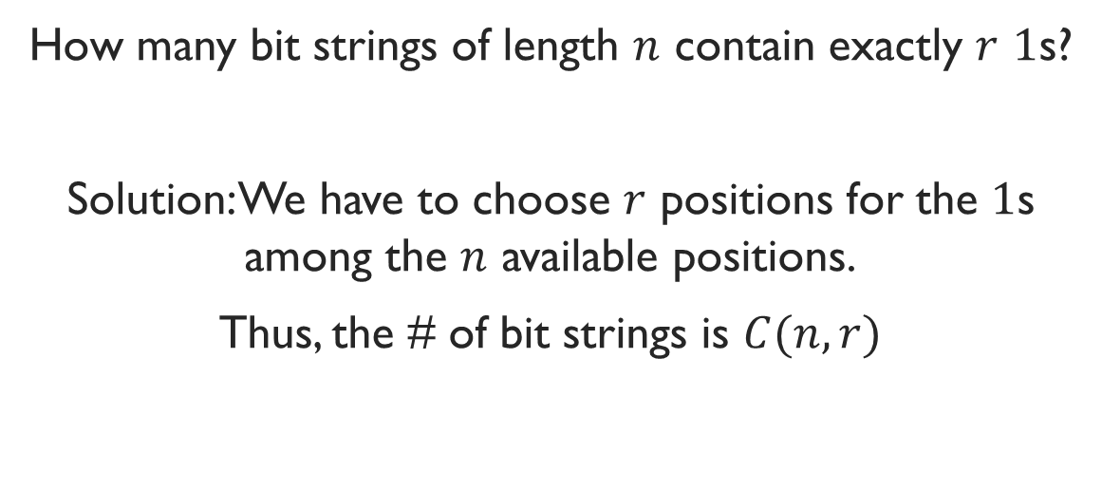
Example
How many bit strings of length $n$ contain exactly $r$ $1$s?
Solution: We have to choose $r$ positions for the $1$s among the $n$ available positions.
Thus, the # of bit strings is $C(n,r)$

Slide 19
Example
There are 9 Math faculties and 11 CS faculties in a university. The authority wants to form a committee to develop a Discrete Math course, such that 3 members of the committee are Math faculties, and 4 are CS faculties.
How many ways to form the committee?

